Slide 1
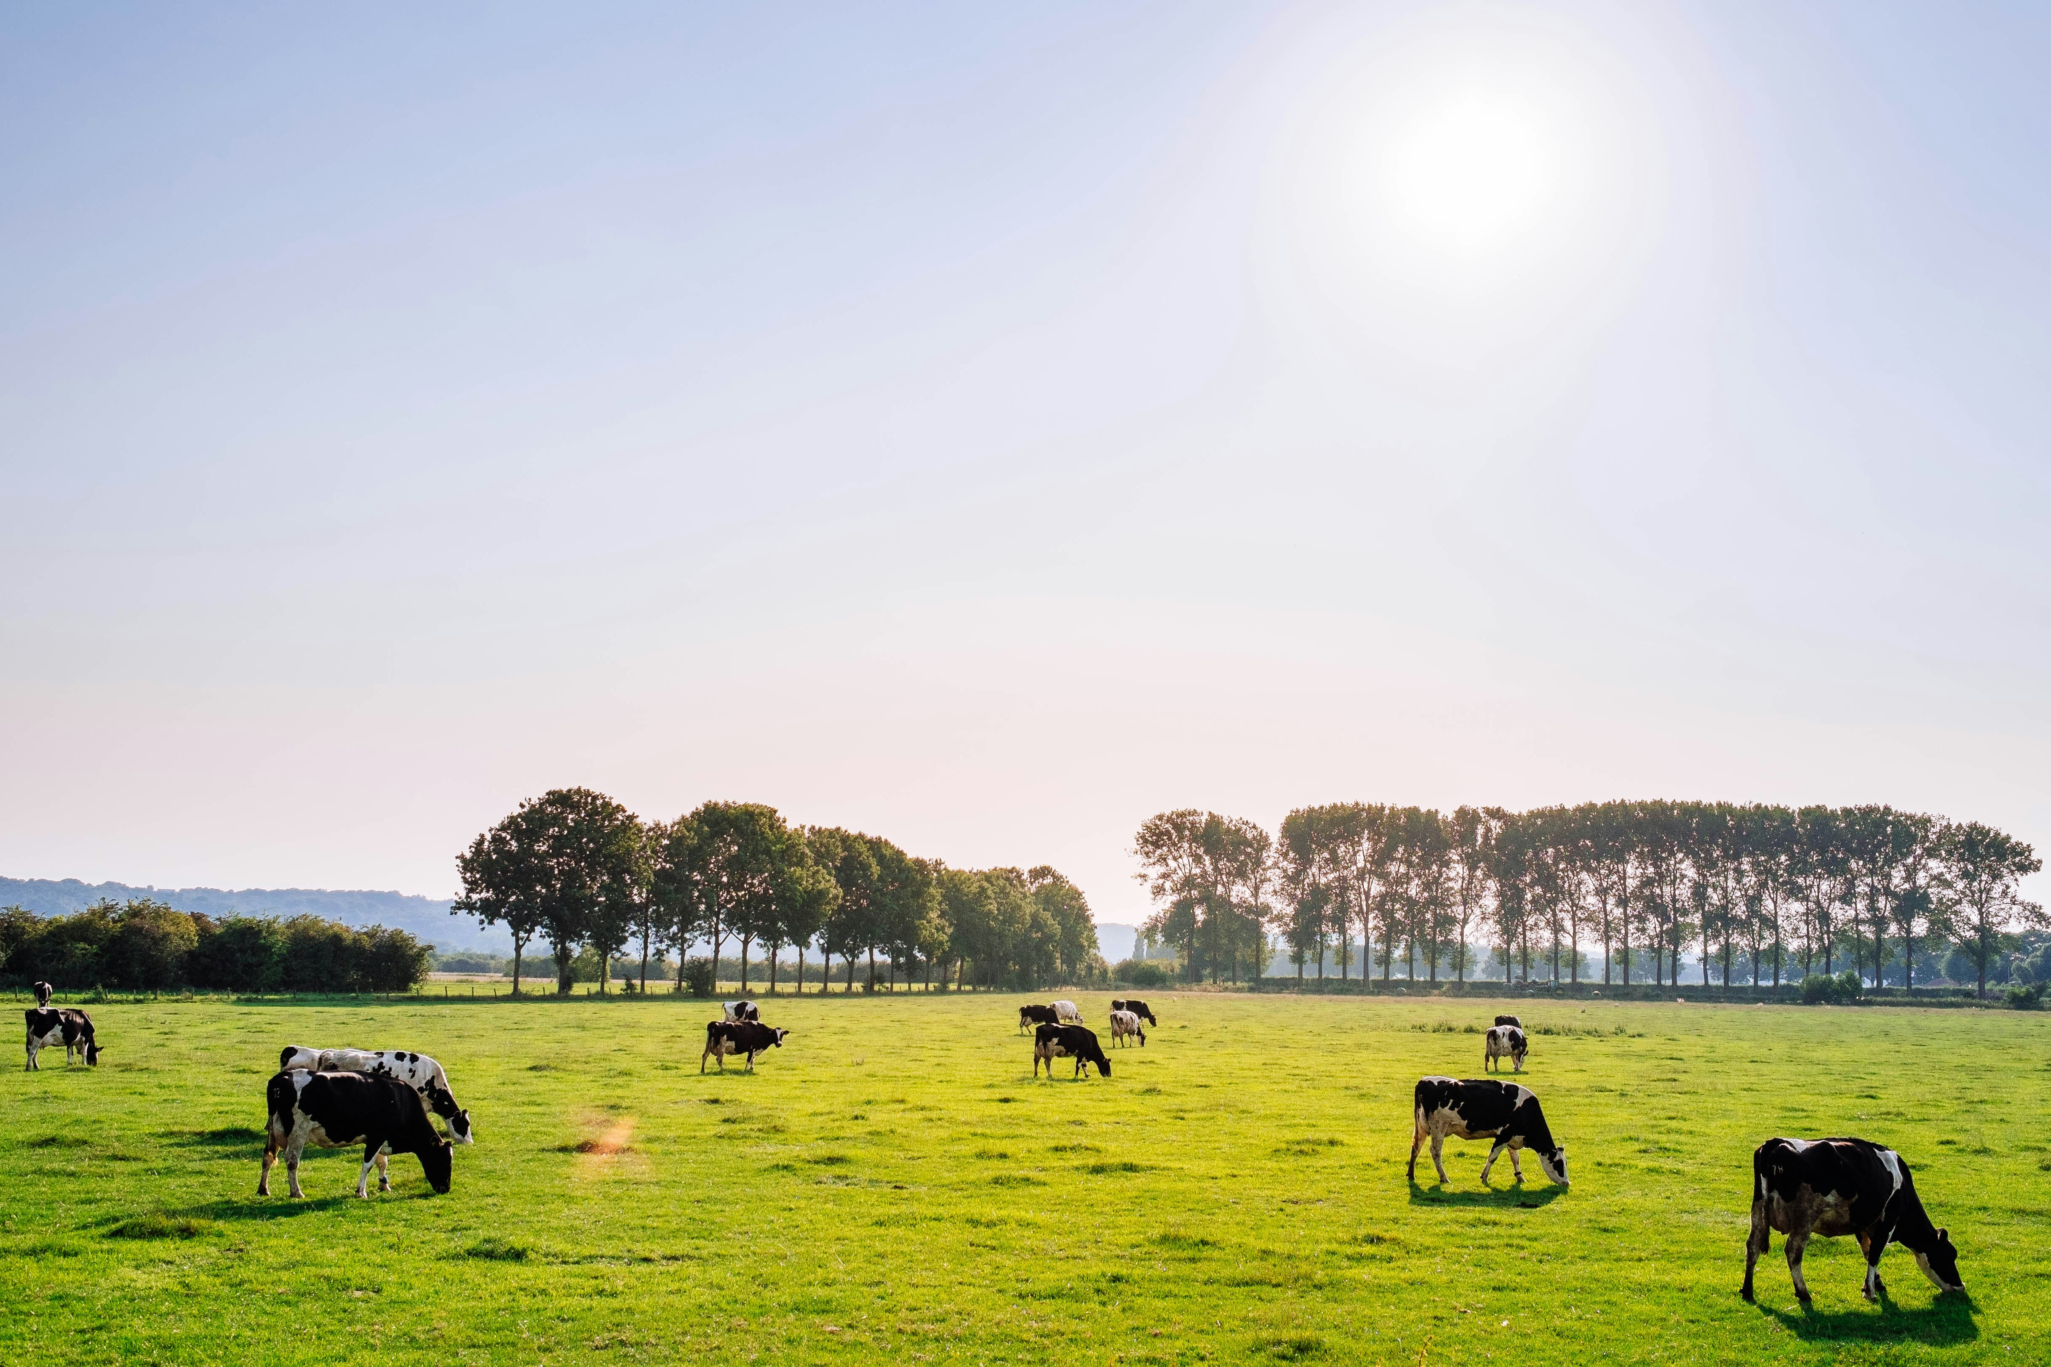

DAIRY
CARE
SYSTEM
Comprehensive Dairy Management

Slide 2
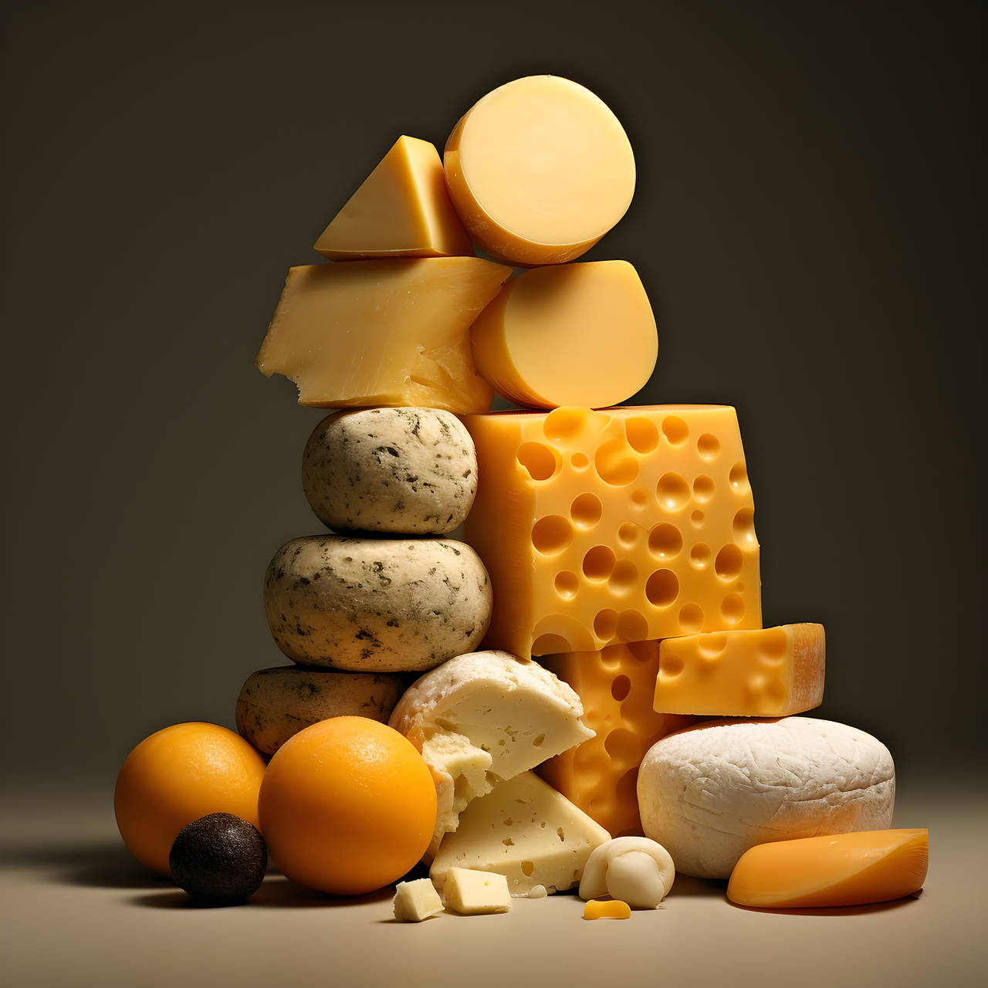
Introduction
Objective: A comprehensive web application designed to enhance the efficiency, productivity, and profitability of dairy farms. Developed using Django, the Dairy Care System enables farmers to streamline livestock management, product sale, order delivery, milk quality analysis, and disease detection, providing an all-encompassing platform for dairy farm operations.
Overview: This system facilitates user-friendly management across multiple roles, from administrators to customers, allowing complete oversight and interaction within dairy operations - covering sales, product inventory, farm monitoring, and customer feedback.

Slide 3
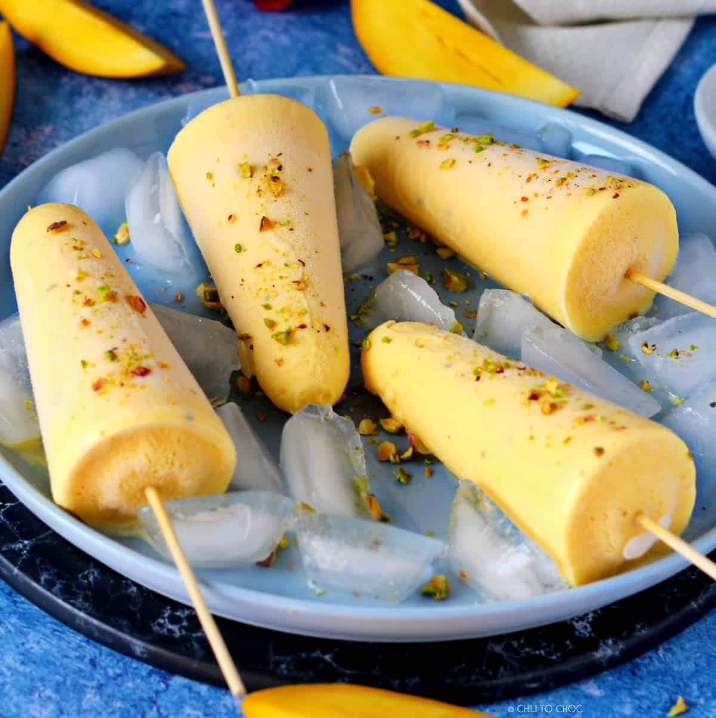
Users
Admin:
Role: Oversee entire farm operations.
Access: Full access to all features, including permission management and revenue distribution.
Employee:
Role: Conduct farm-specific tasks like livestock management and monitoring health, product sale, feedback reviews, sales analytics management.
Access: Register, manage profile, access to all farm related tasks.
Customer:
Role: Browse products, make purchases, track order, submit feedback.
Access: Register, manage profile, purchase and pre-purchase products, track order and provide feedback.
Delivery Agents:
Role: Manage assigned deliveries and update order status.
Access: Manage profile, manage deliveries, update order status and provide real time tracking.

Slide 4

Functionalities
User Authentication & Management:
Secure login and registration for all user roles.
Farm Monitoring:
Livestock Management : Monitor milk quality and provide livestock disease detection.
Product Management: Add, update, delete product details and order management.
Product & Inventory Management:
Product Search & Purchase: Customers can buy products, track delivery and provide feedbacks.
Product Analysis: Owners can analyze demand market pricing based on supply analytics.
Payment Processing:
Customer Payment: Process online transactions via Razor-Pay or handle cash on delivery.
Feedback & Analysis:
Feedback Submission: Customers submit feedback on products and services.
Feedback Analysis: Admin and farm owner analyzes customer feedback to improve operations.
Delivery Management:
Delivery Assignments : Delivery agents are assigned deliveries based on pincode.
Delivery Tracking: Update delivery status providing real time order tracking.

Slide 5
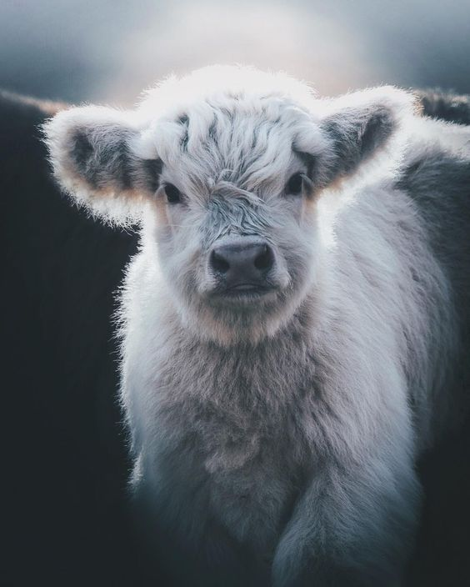
Technologies
Frontend: HTML, CSS, JavaScript for a responsive and interactive interface
Backend: Django (Python-based framework) for handling logic, database management, and authentication
Database: MySQL for storing user, product, order, and farm data securely
Operating System: Windows (for development environment)
Technologies: Machine Learning, Convolutional Neural Networks, Artificial Intelligence, Git
IDE: Visual Studio Code

Slide 6
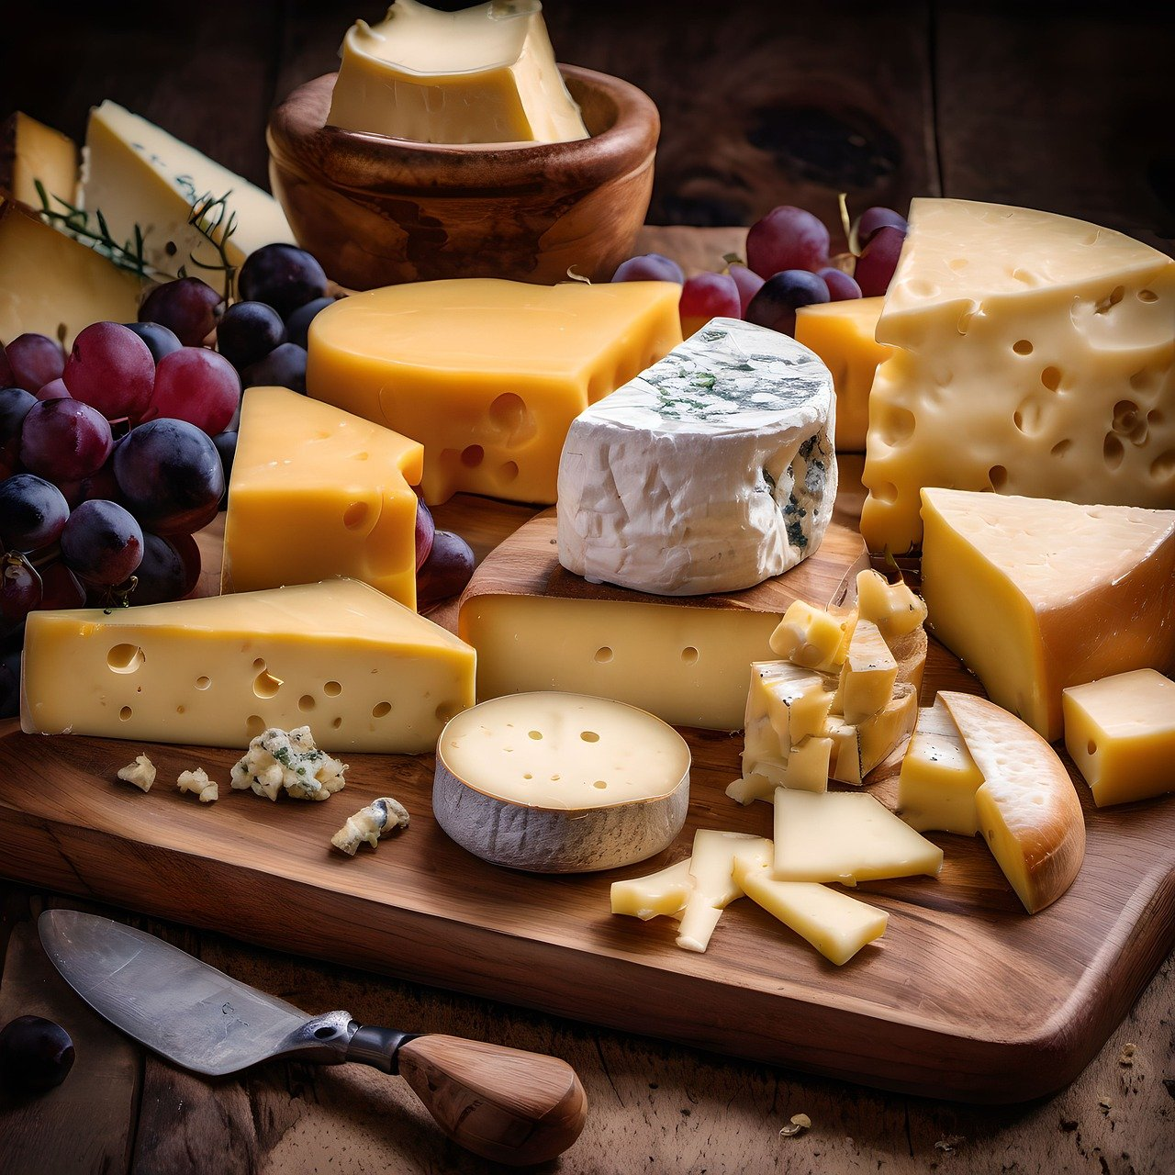
Future Scope
Non-Dairy Product Expansion:
Expand product offerings to include non-dairy alternatives
for a broader customer base.
Advanced Analytics:
Integrate machine learning for data-driven insights on
optimized feeding schedules and diet managements.
Mobile Application Development:
Create a mobile app to allow customers and farm owners
on-the-go access to purchasing, order management, and
farm monitoring features.
IoT Integration:
Implement IoT sensors for real-time tracking of milk
yield, animal health, and environmental conditions within
the farm.
Expanded Payment Gateways:
Integrate additional payment options for customers.

Slide 7

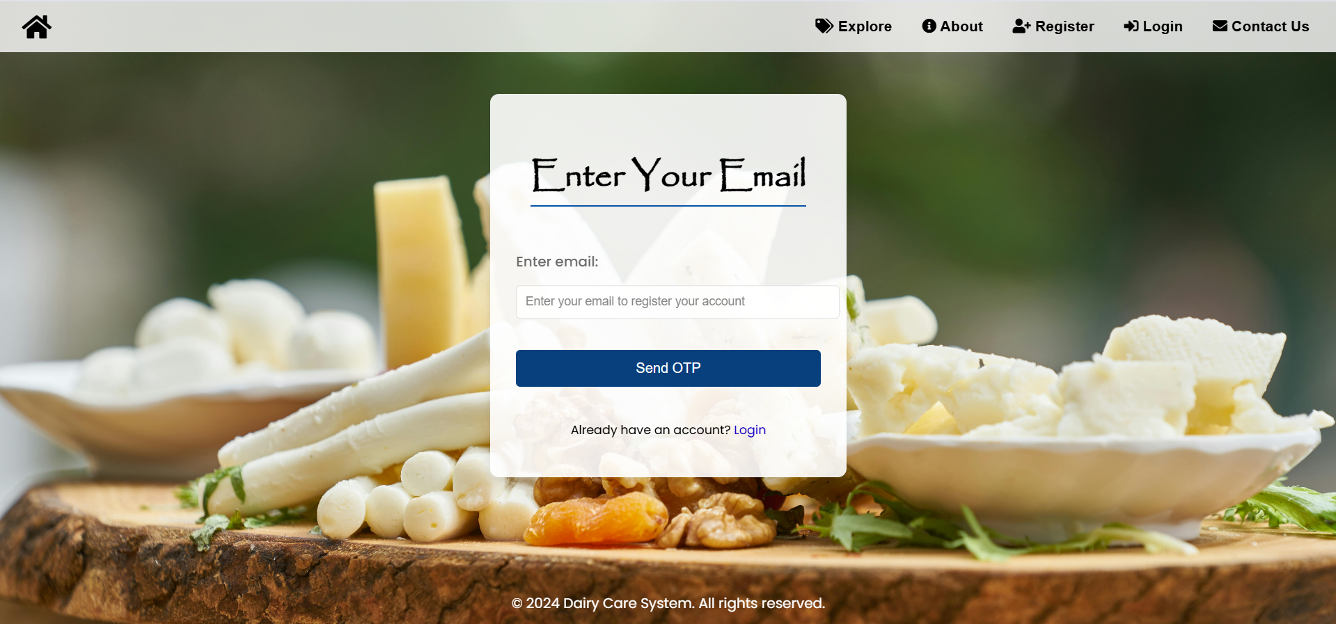
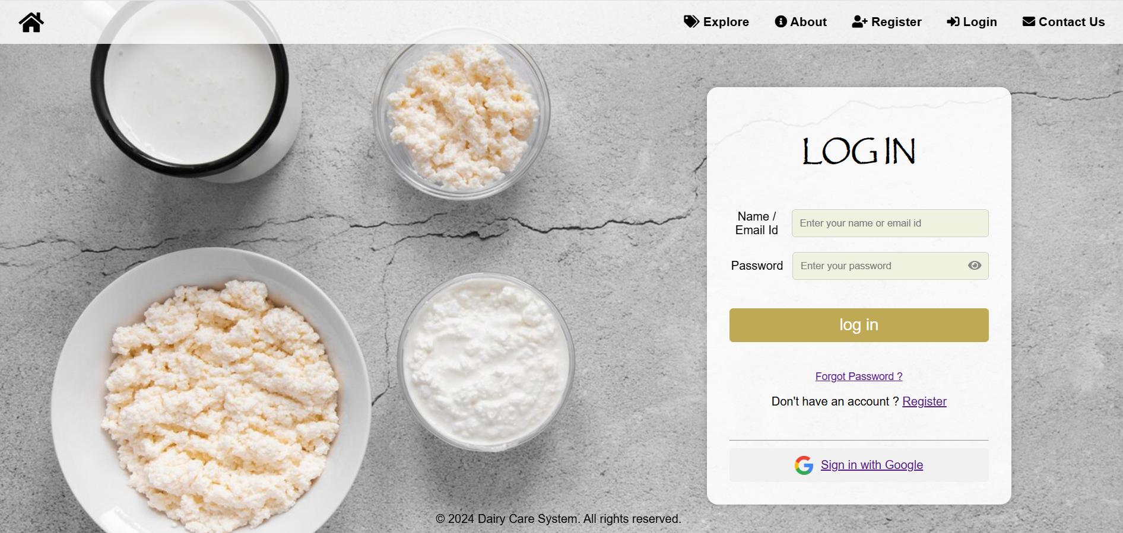

Slide 8
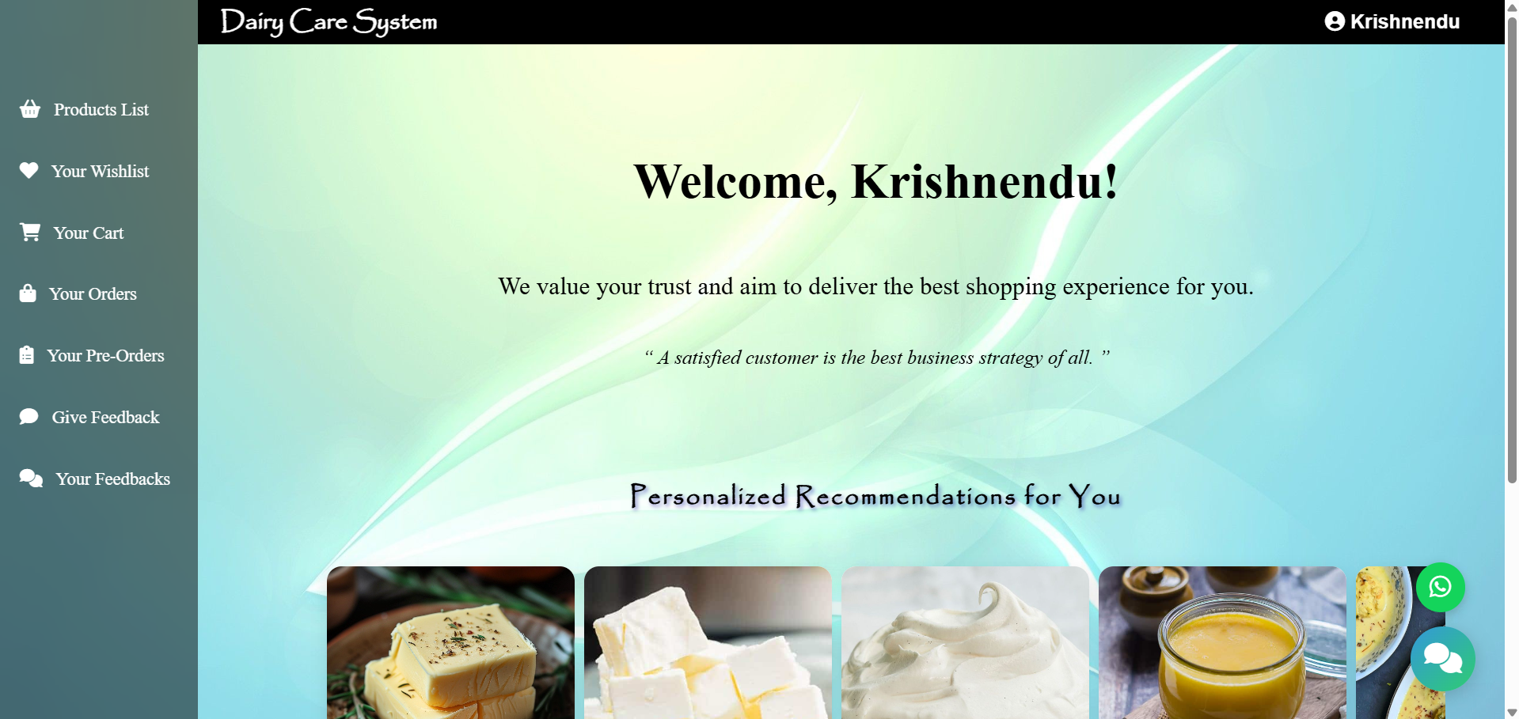
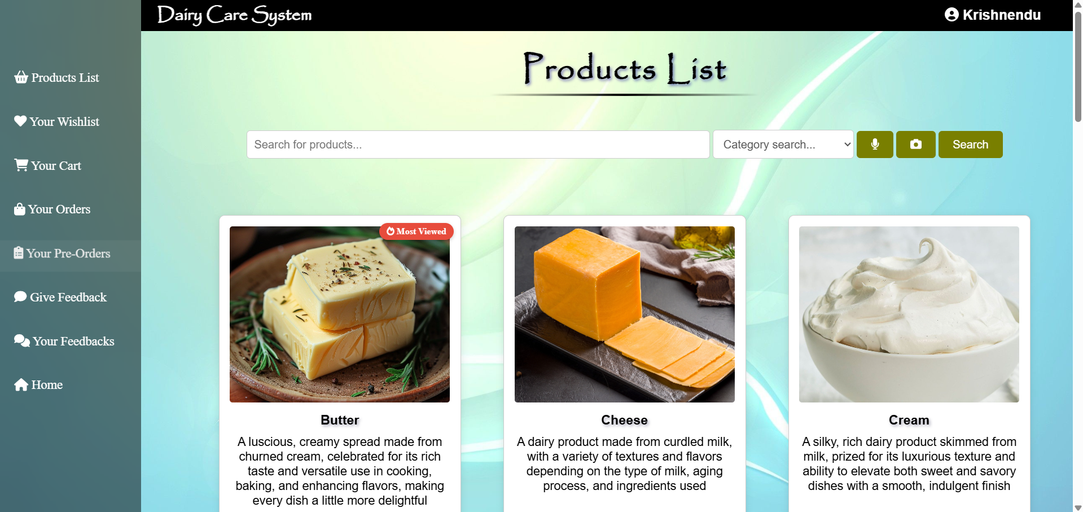
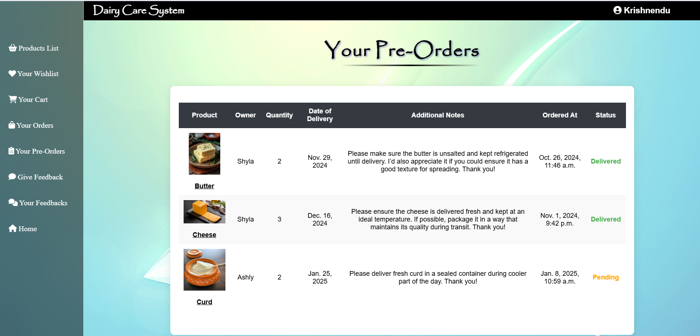

Slide 9
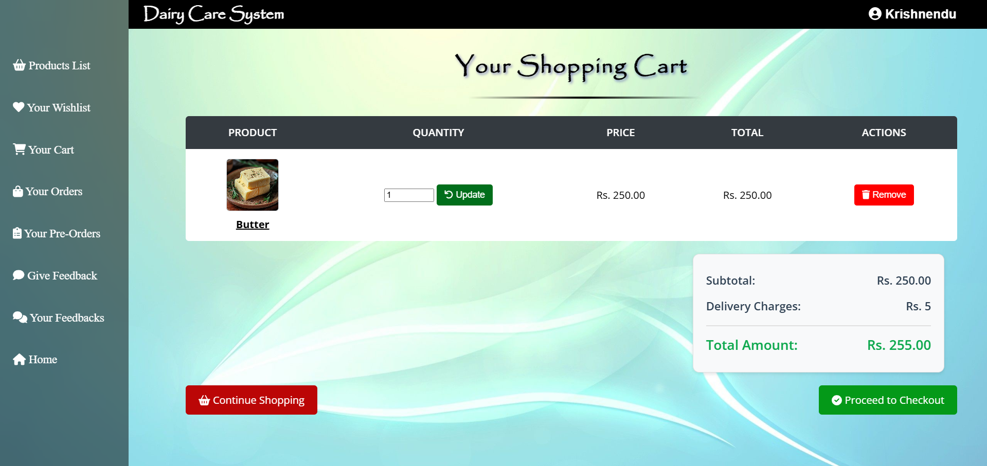
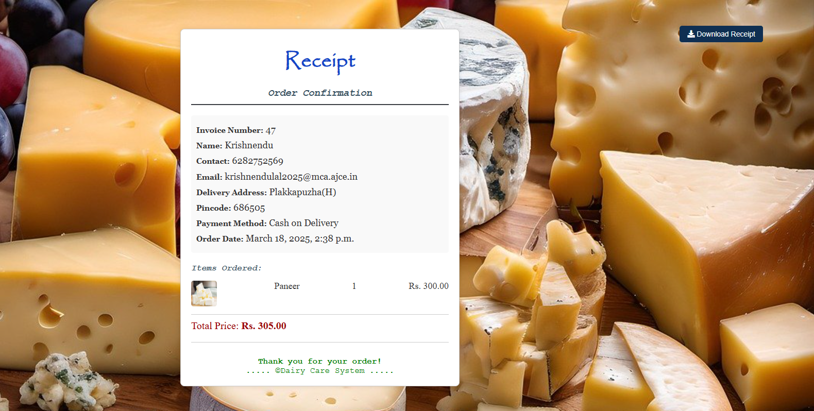
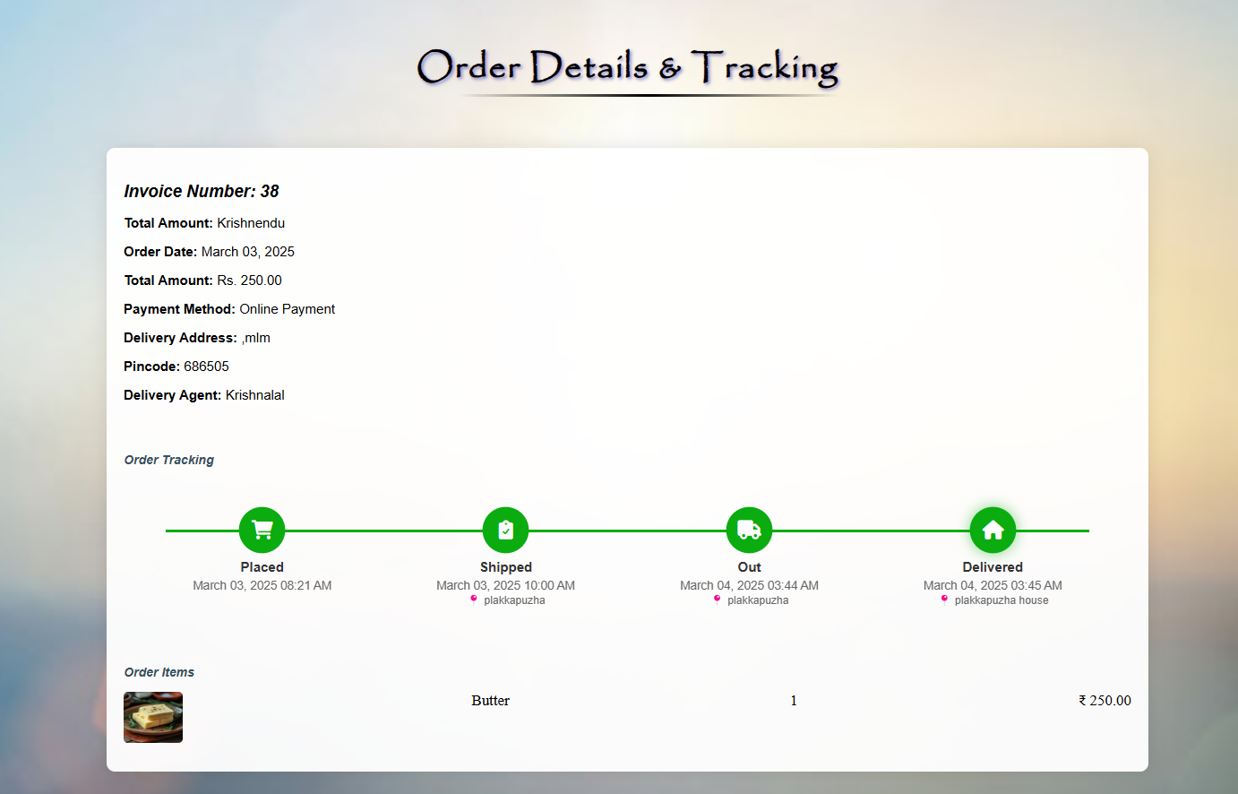

Slide 10
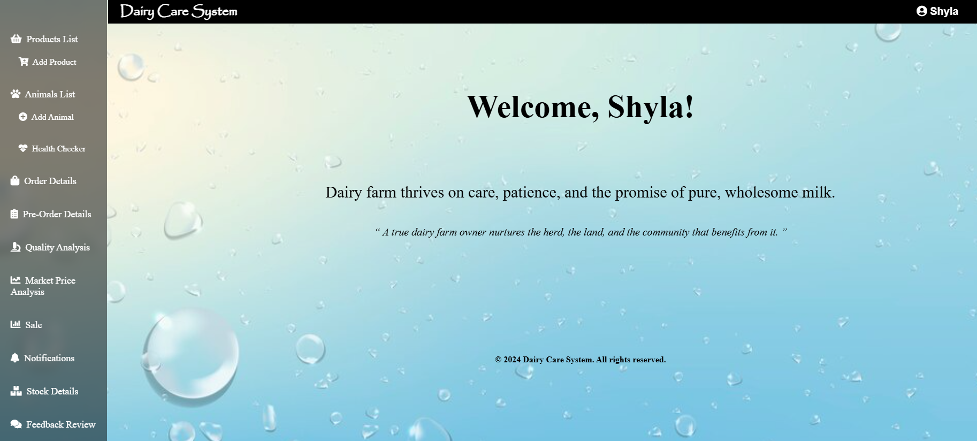
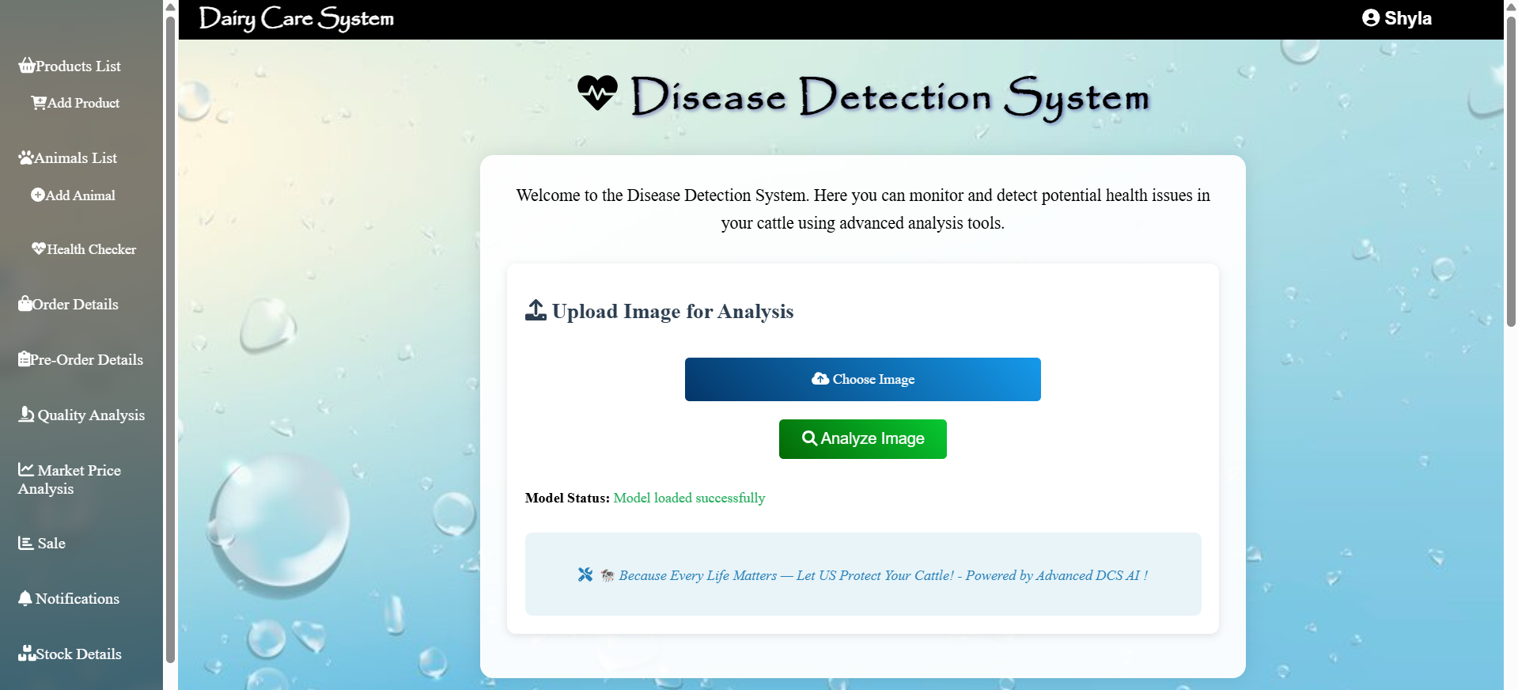
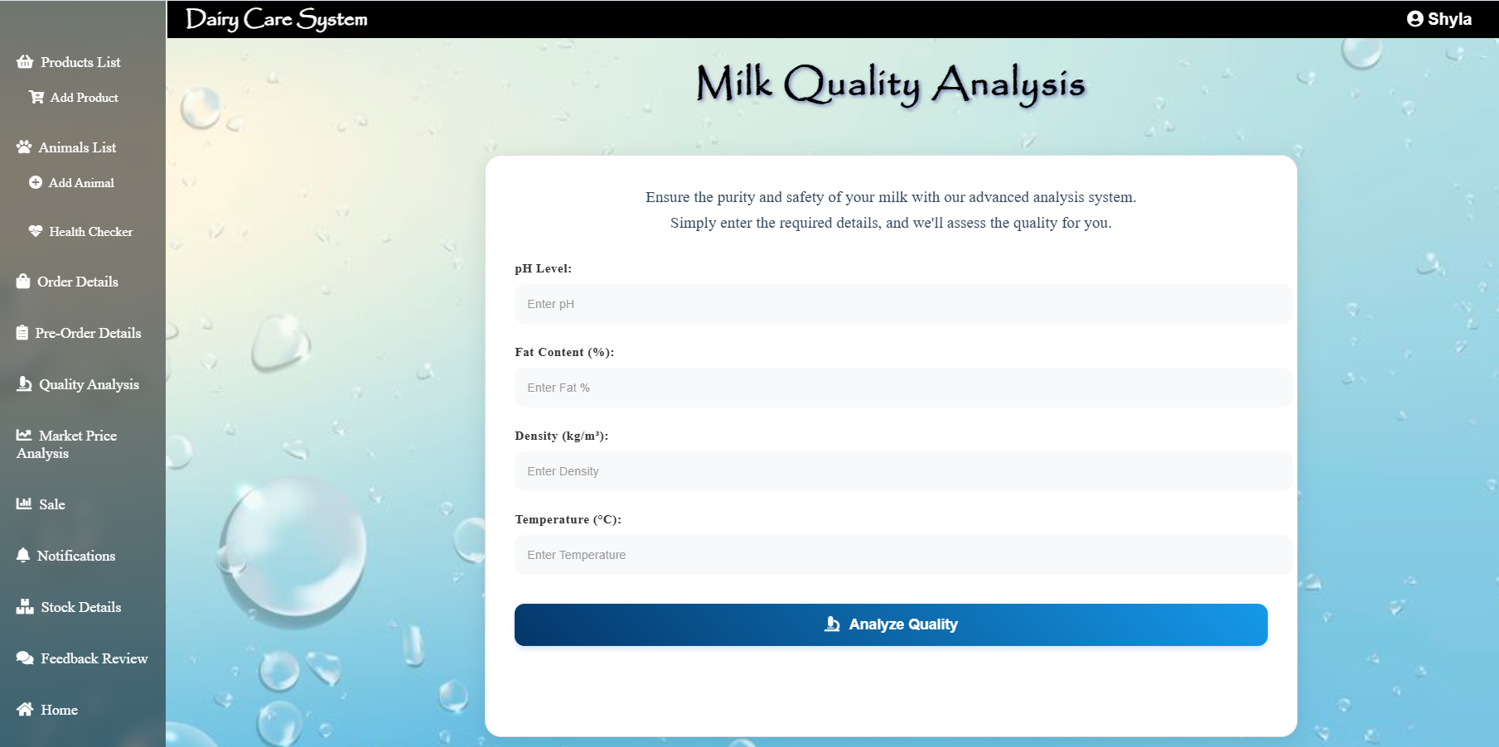
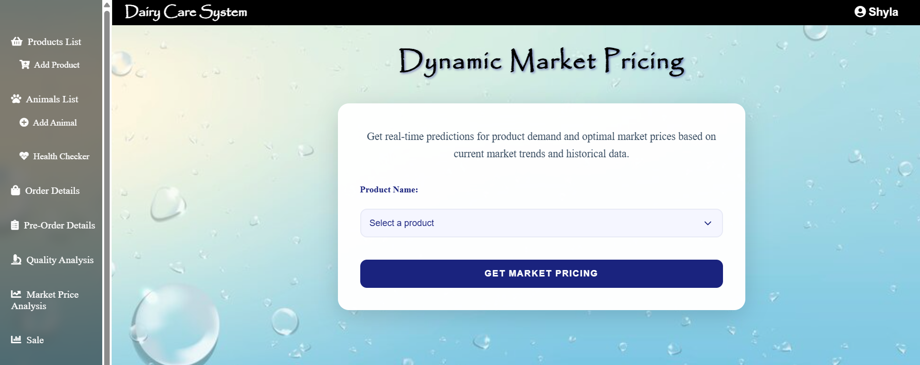

Slide 11
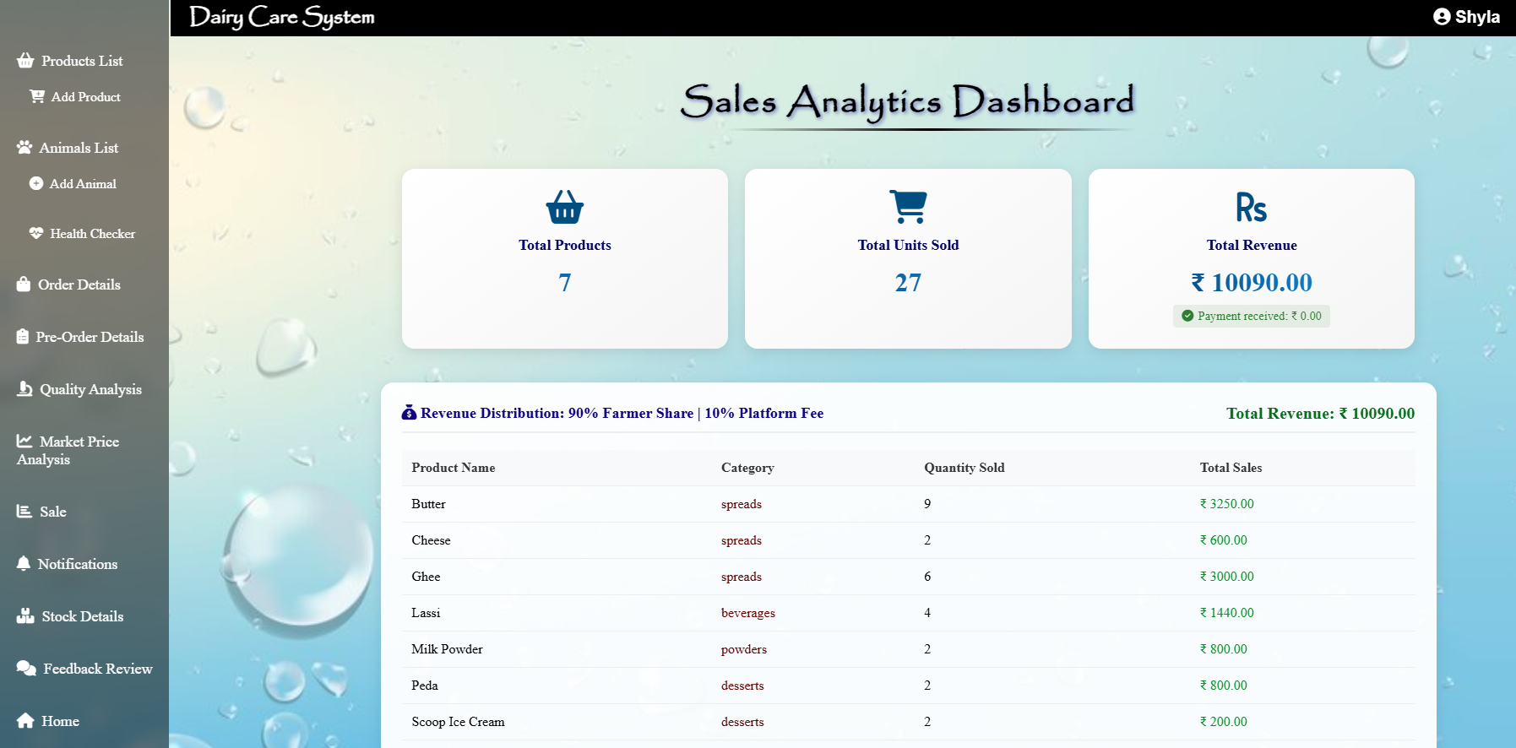
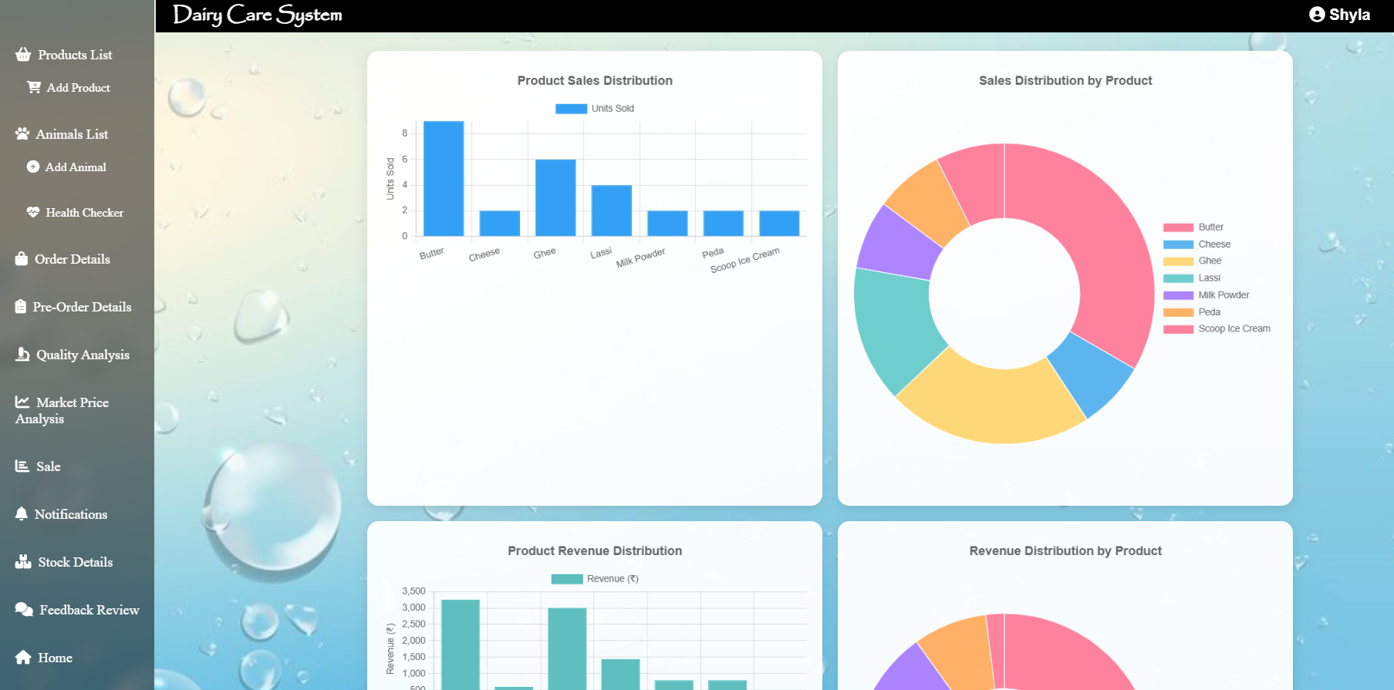
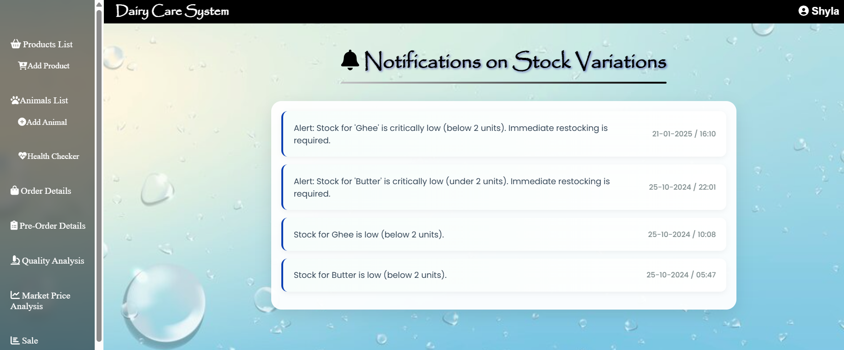
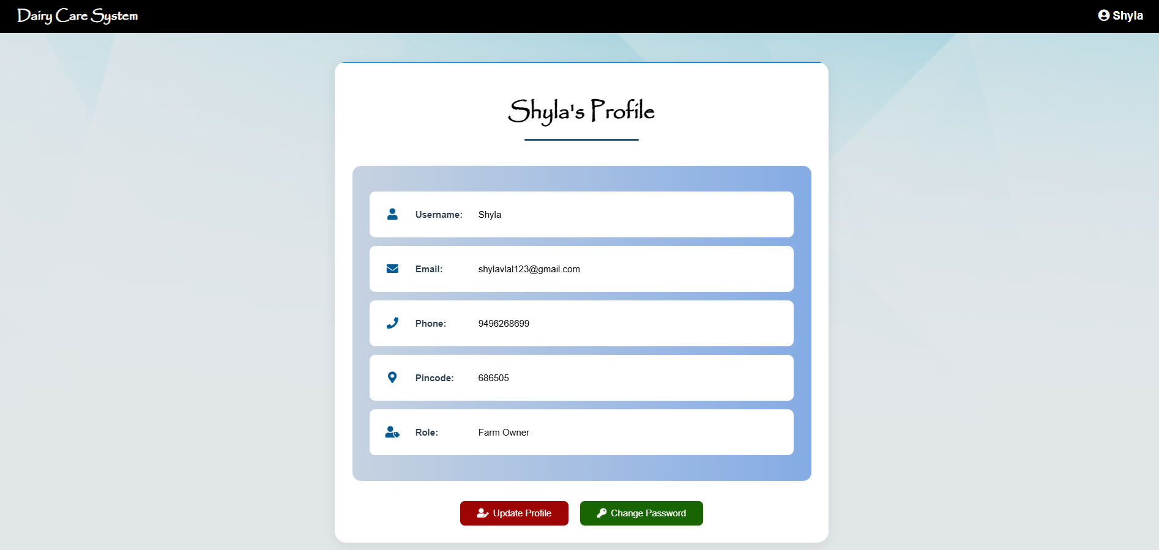

Slide 12
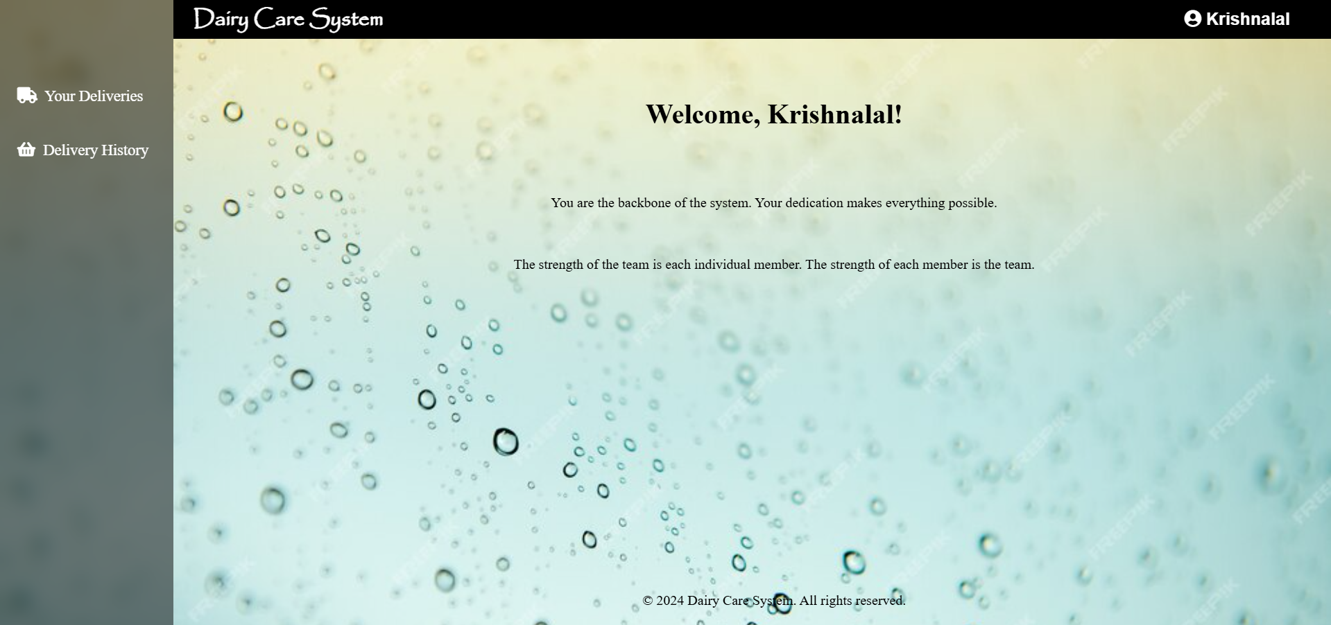
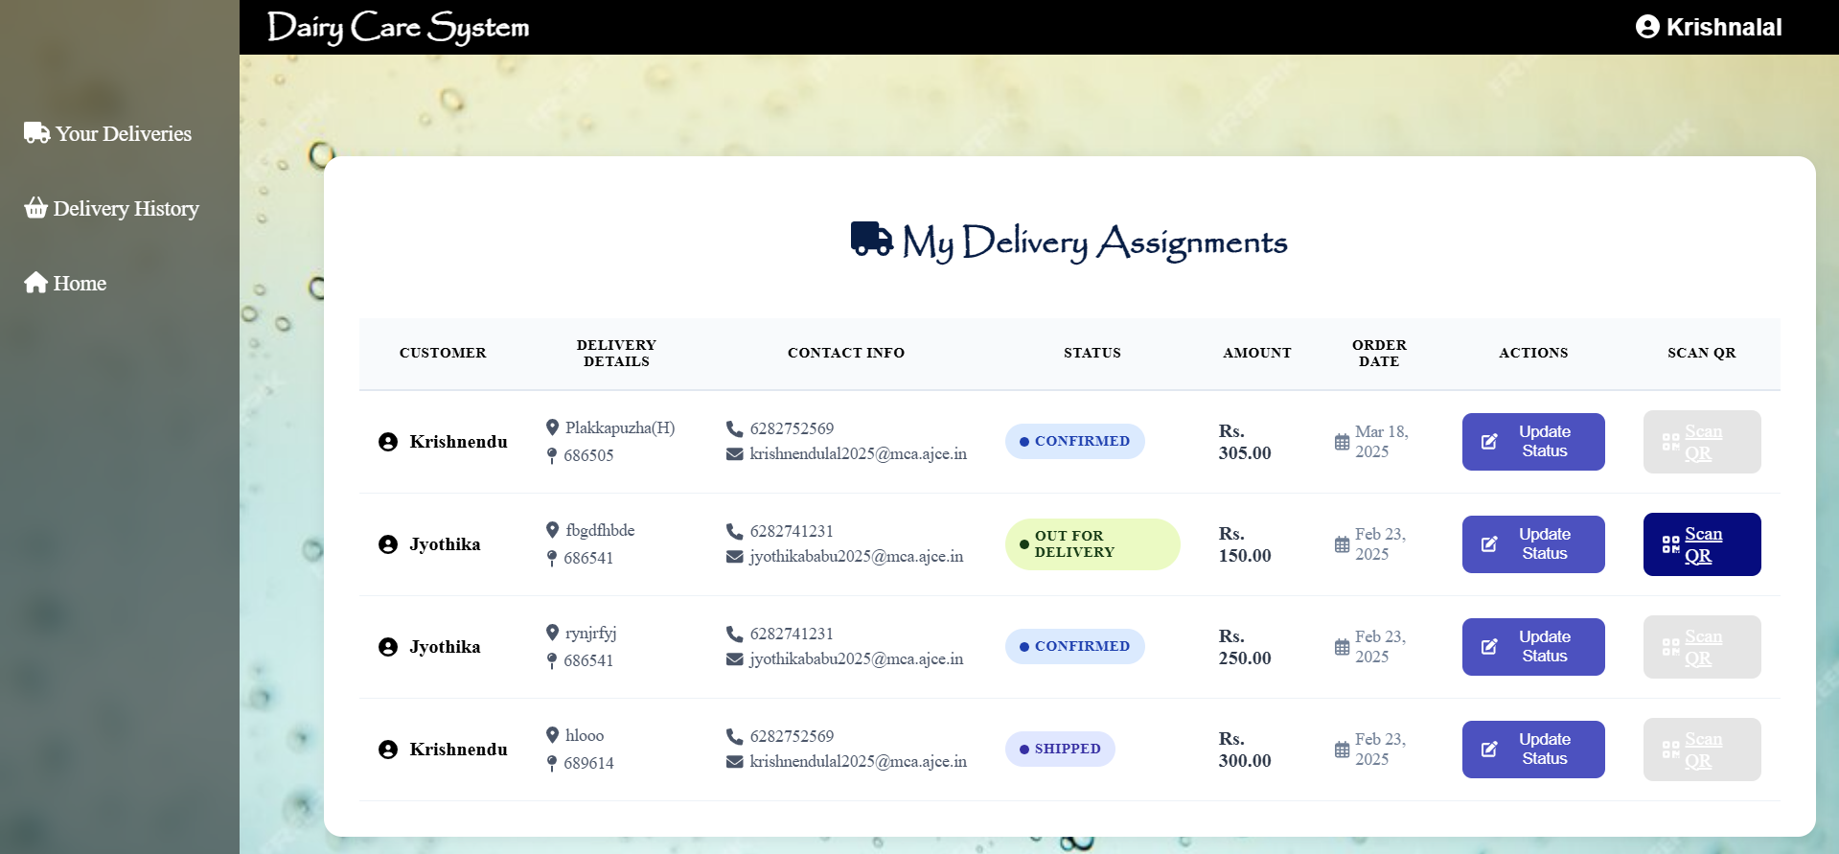
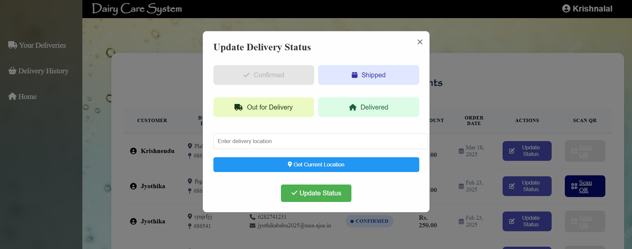
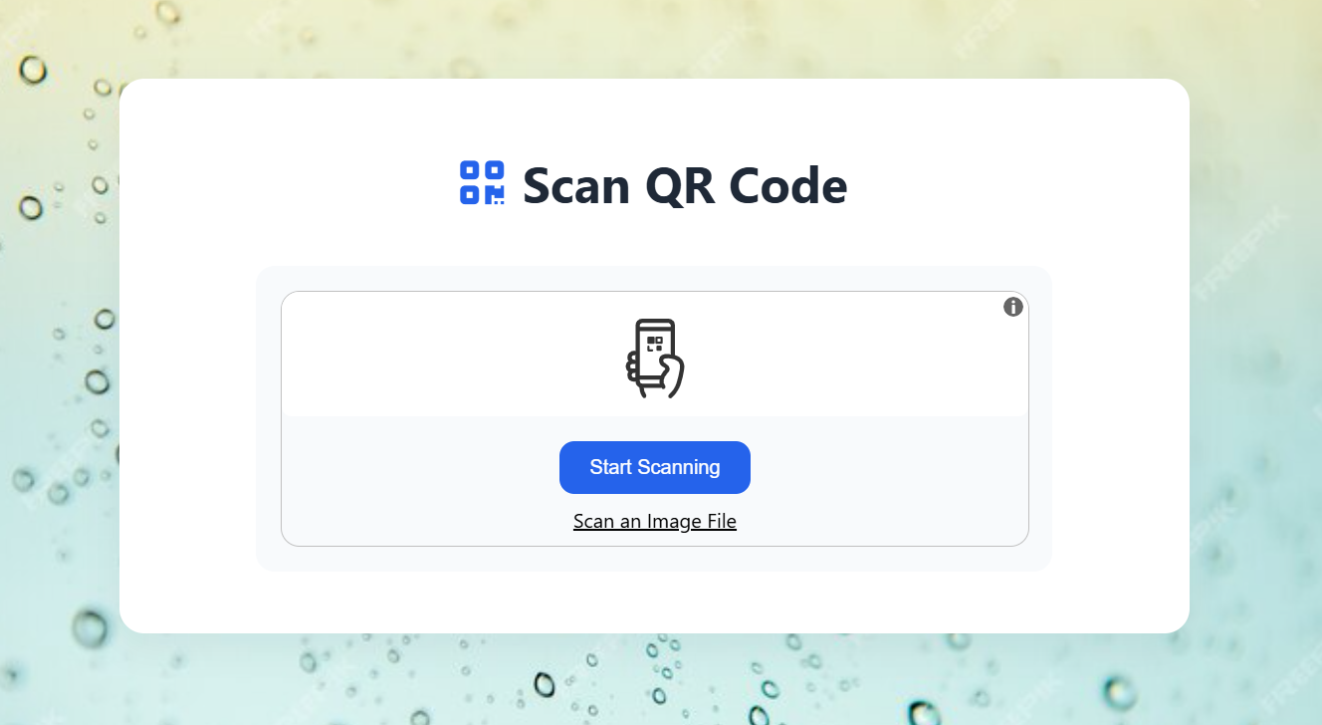

Slide 13
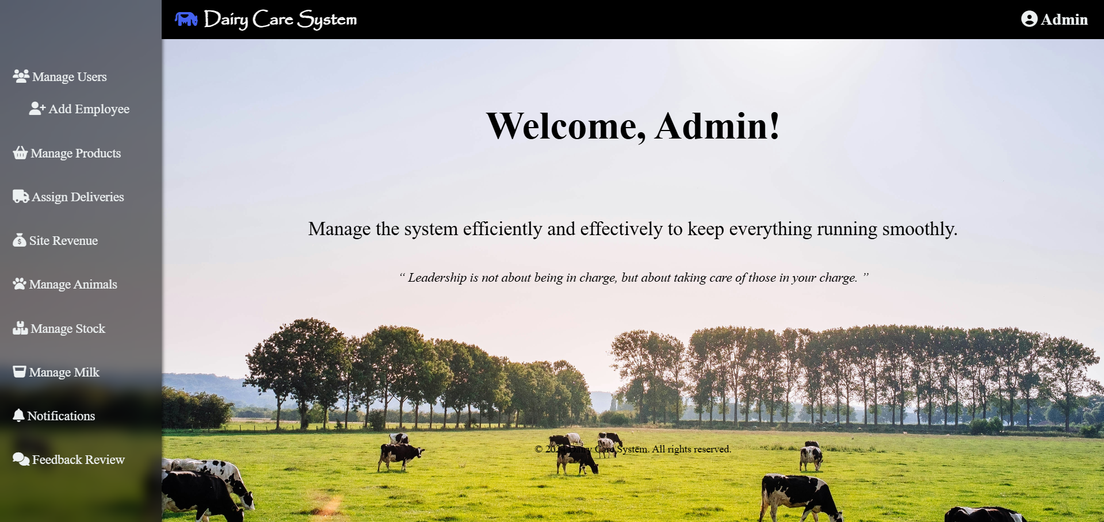
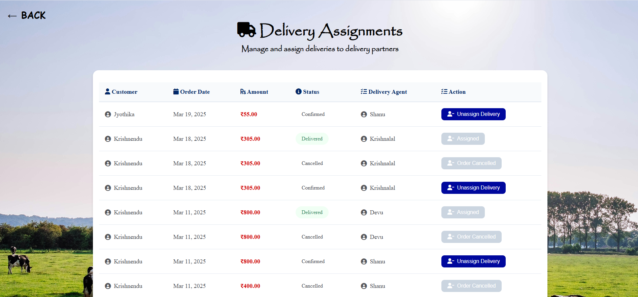
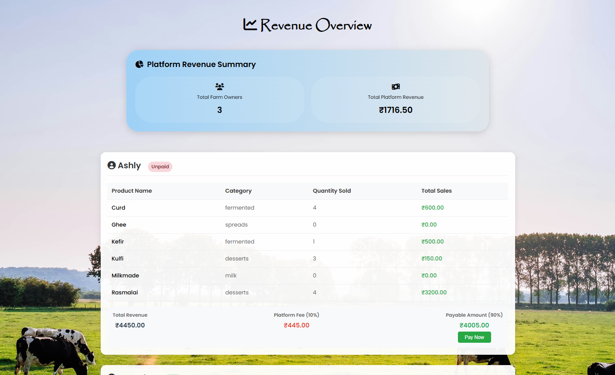

Slide 14
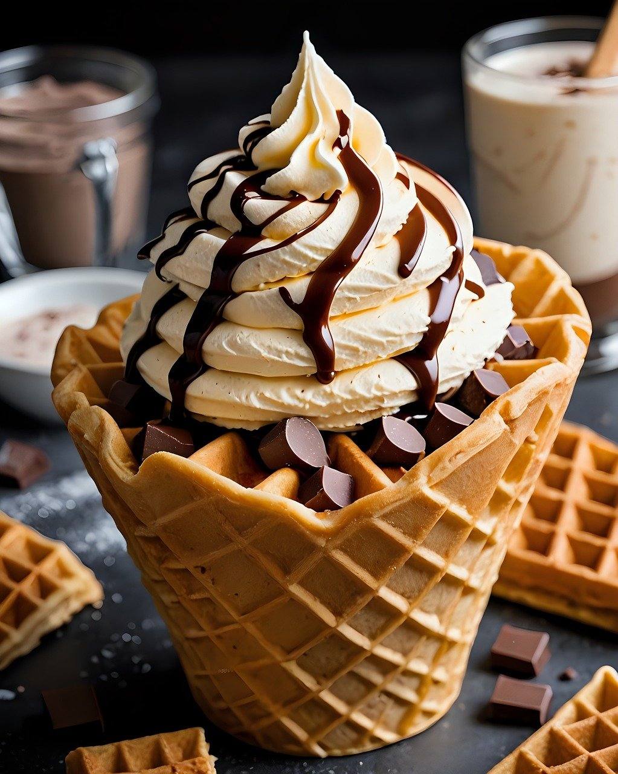
Conclusion
The Dairy Care System serves as a versatile, efficient platform for managing dairy farm operations, improving productivity, and also transparency, and customer satisfaction.
Provide innovative features, such as predictive analytics, AI-driven virtual assistance, and dynamic market strategies, the system empowers farm owners to optimize operations, enhance productivity, and ensure superior customer experiences.
Empowers farm owners to optimize workflows, ensures the well-being of livestock, enhances sales management, and strengthens the customer relationship through streamlined farm management.

Slide 15
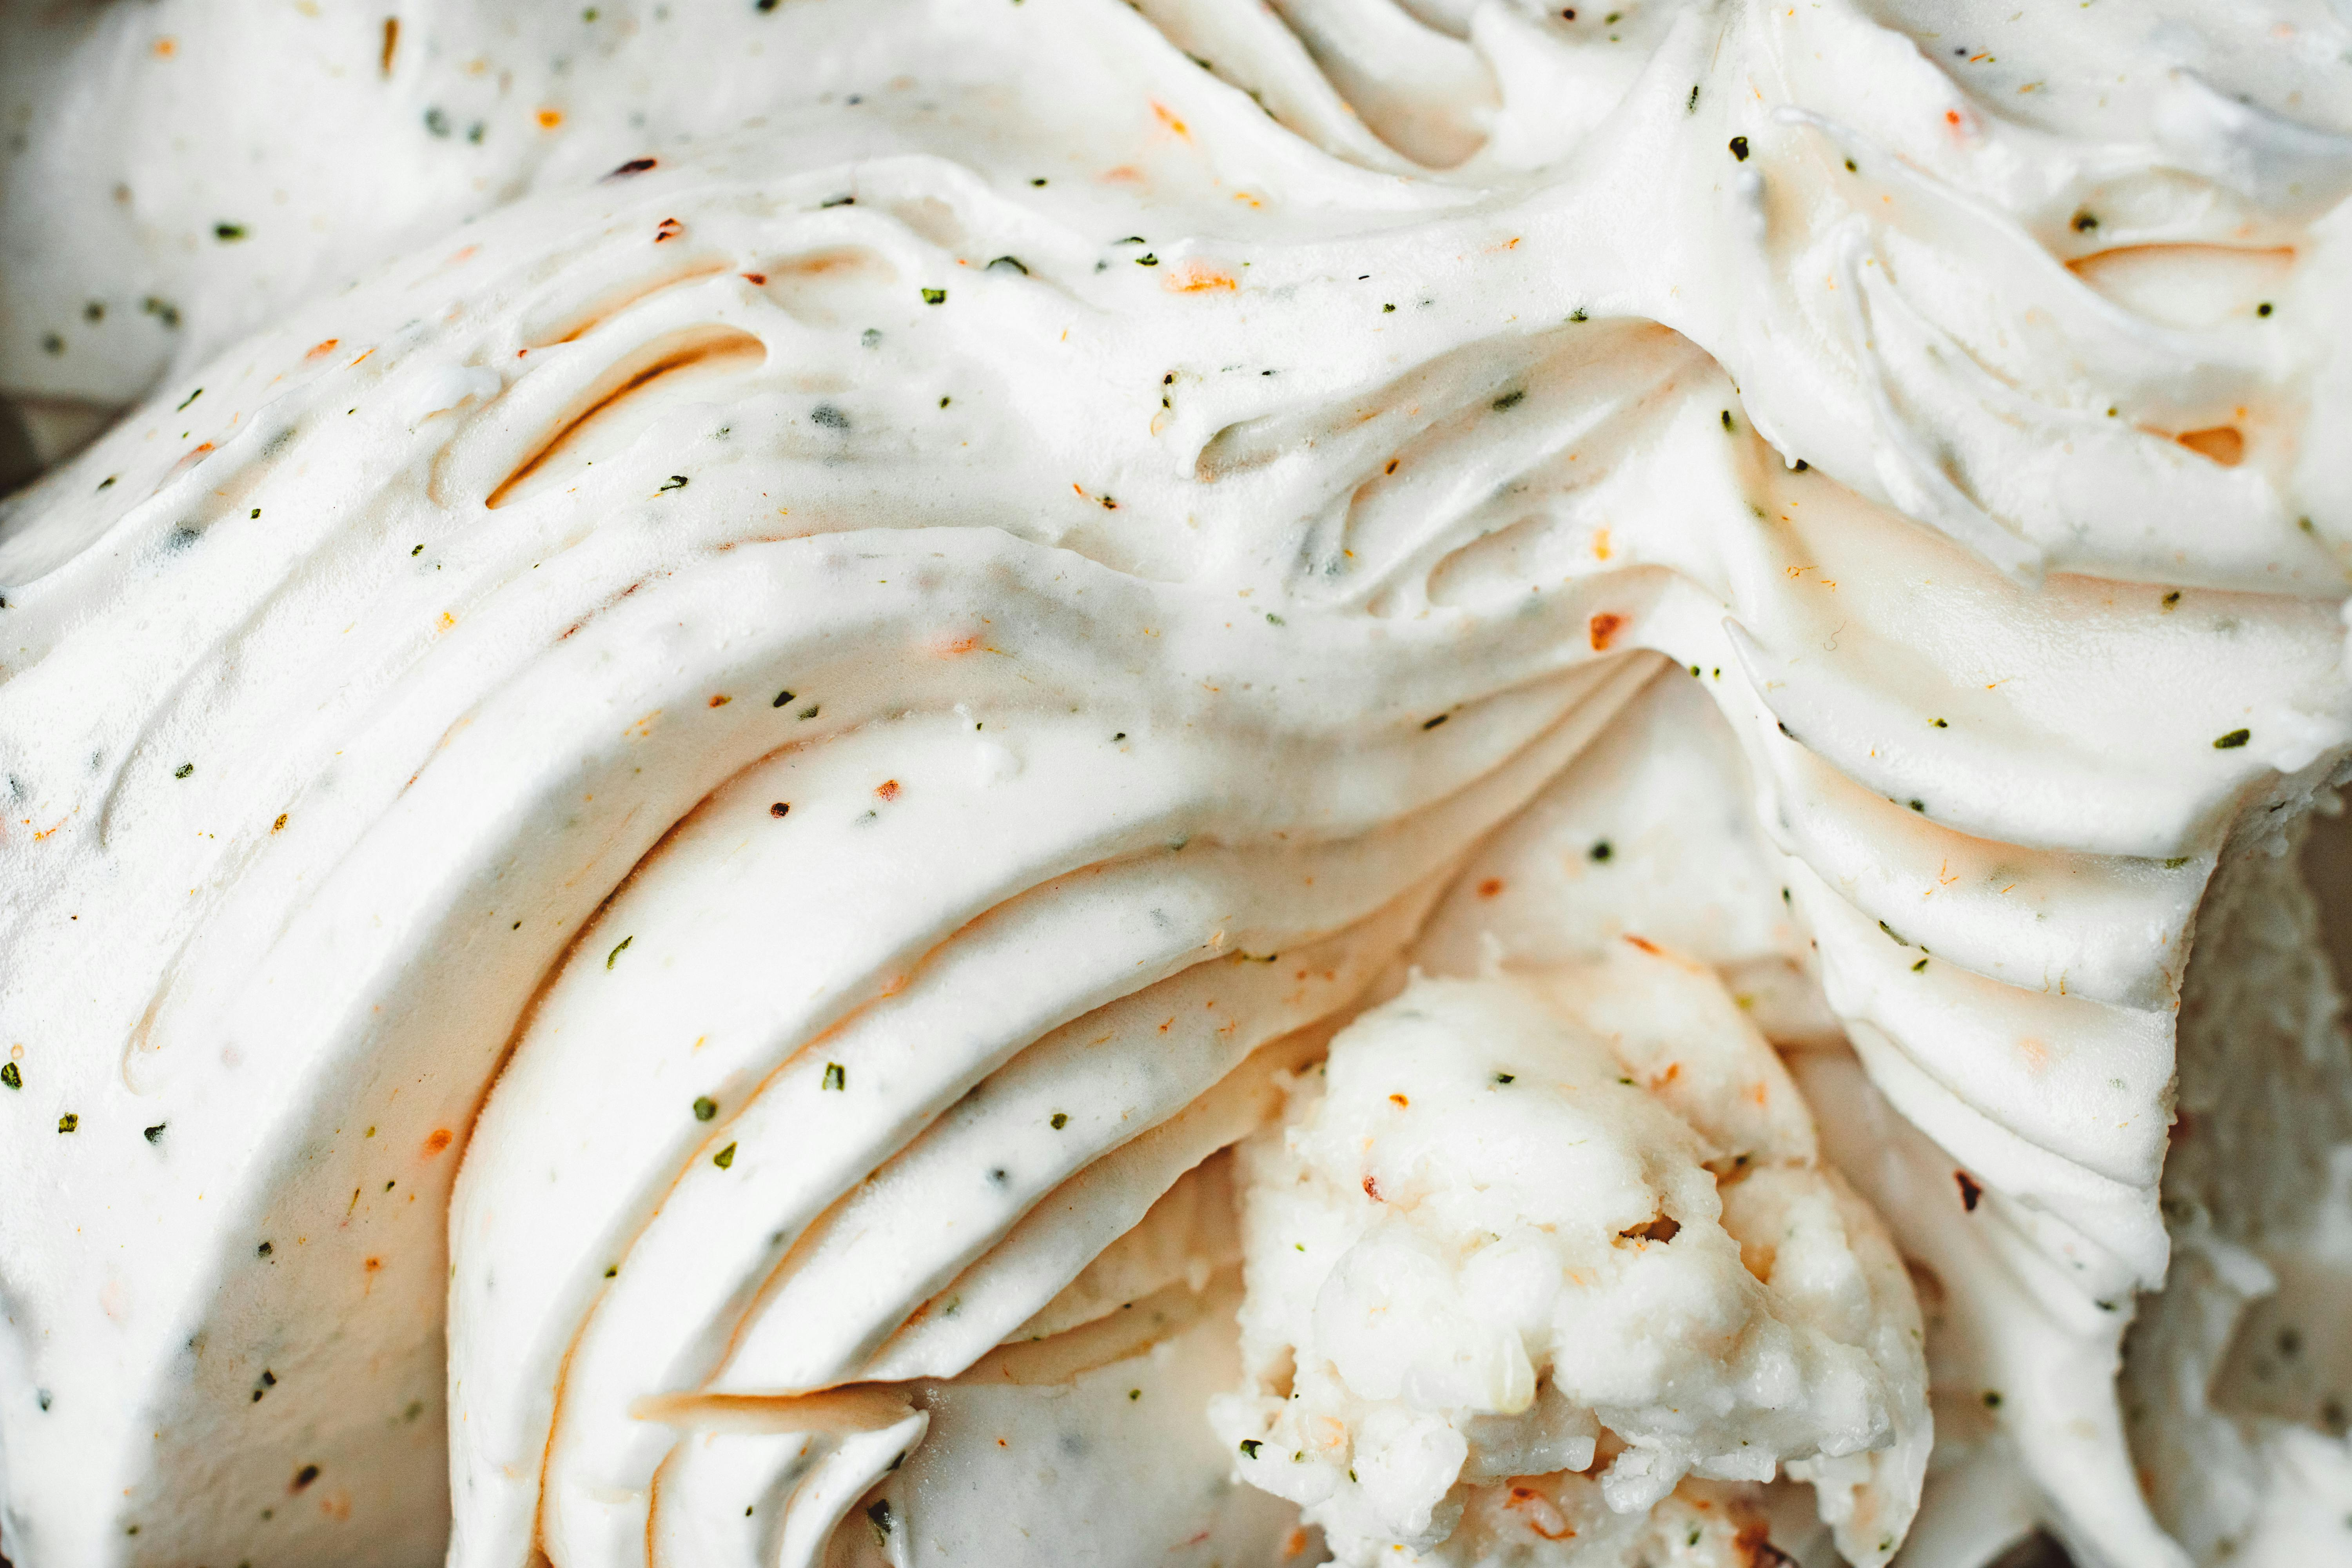
THANK
YOU
By,
Krishnendu Lal
S4 Regular MCA
2023 - 2025
To,
Mr. Amal K Jose
Assistant Professor
Amal Jyothi College of Engineering (Autonomous),
Kanjirappally, Kottayam

